Slide 1

Airline Profitability model

Slide 2
agenda
Solve Airline Profitability Challenge
Understanding the Key Features Impacting Profitability
Visualize Data Insights & Key Drivers
Evaluation Metrics and Model Performance
Actionable Insights for Operational Optimization
Conclusion and Key Takeaways

Slide 3

Introduction
The airline industry operates in a highly competitive environment, where profitability is influenced by a range of operational and financial factors.

Slide 4
Airline profitability challenge
Maximizing profitability requires understanding the complexities of various variables that directly impact both costs and revenue generation.
With a dataset that captures a wide range of operational metrics and financial figures, the goal is to build a model that can predict airline profitability accurately and provide actionable insights for decision-making

Slide 5

Problem statement
The airline industry faces challenges in maximizing profitability, influenced by factors like flight delays, aircraft utilization, turnaround time, and fuel efficiency. By predicting profitability based on these factors, airlines can make informed decisions to improve operational efficiency, reduce costs, and boost revenue.

Slide 6
OBJECTIVES
Develop a Predictive Model
Ensure High Predictive Accuracy
Provide Interpretability:
Handle Real-World Uncertainties
Optimization and Parameter Tuning

Slide 7
machine learning model
XGBoost Model
XGBoost (Extreme Gradient Boosting) is a powerful machine learning algorithm
XGBoost works by combining the outputs of several weak models (typically decision trees) to form a strong predictive model.
By utilizing techniques like regularization, pruning, and feature selection, XGBoost effectively minimizes overfitting and enhances performance.

Slide 8
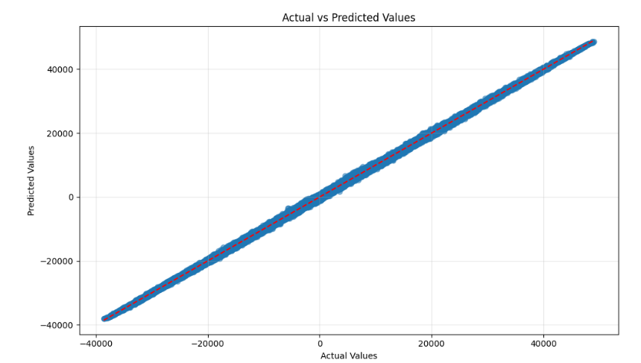
Actual vs predicted values
Ideally, the points should align closely with the diagonal red dashed line, representing perfect predictions. The close alignment in this plot indicates that the model's predictions are highly accurate and closely match the actual values, suggesting a good model fit.

Slide 9
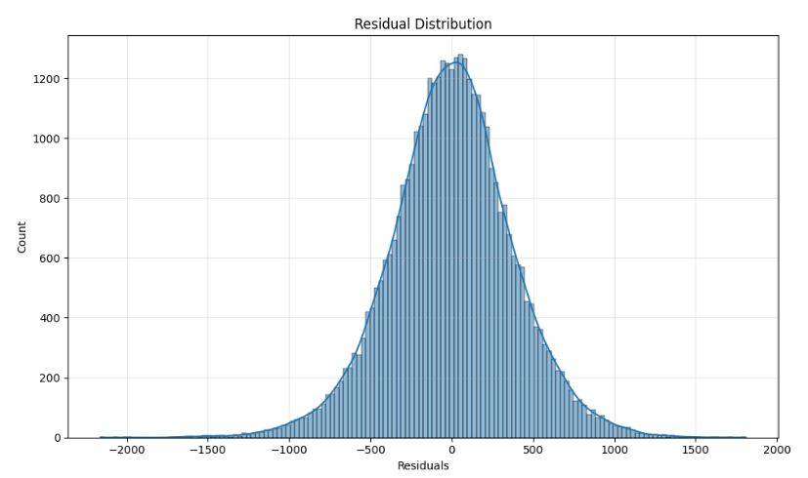
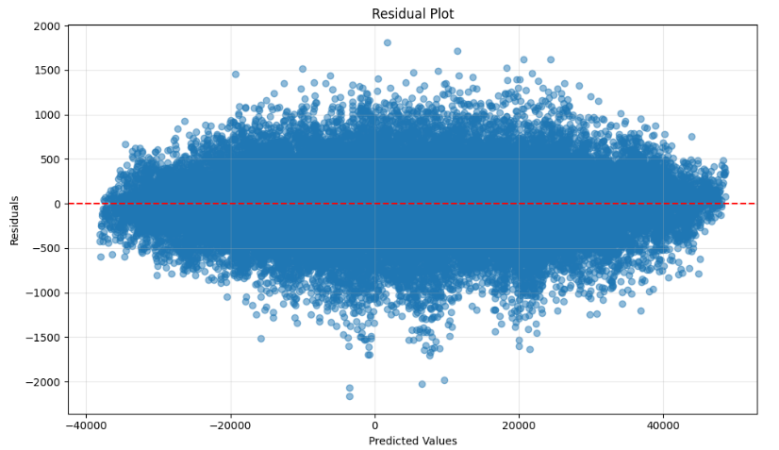
RESIDUAL DISTRIBUTION
This histogram displays the distribution of the residuals (the differences between actual and predicted values). A symmetric, bell-shaped curve around zero indicates that the residuals are normally distributed, suggesting that the model's errors are random and there is no obvious pattern. This is a good sign, as it indicates the model does not have significant biases.

Slide 10
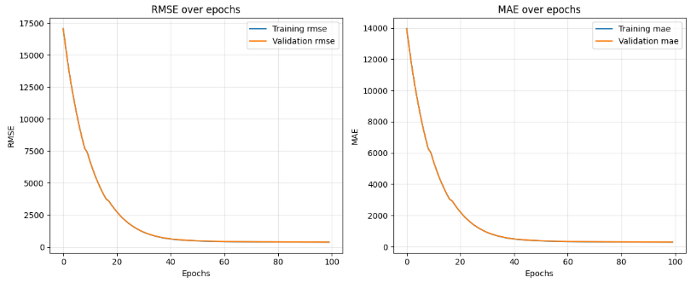
RMSE & MAE OVER EPOCHS
RMSE (Root Mean Squared Error): This chart shows the change in RMSE during the training process. RMSE measures the average magnitude of the errors in predictions. Over epochs, the RMSE steadily decreases, which suggests that the model's performance improves as it learns from the data.
MAE (Mean Absolute Error): Similarly, the MAE chart shows the progression of absolute errors between predicted and actual values. A steady decrease in MAE across epochs signifies that the model is minimizing errors, thereby improving its accuracy.

Slide 11
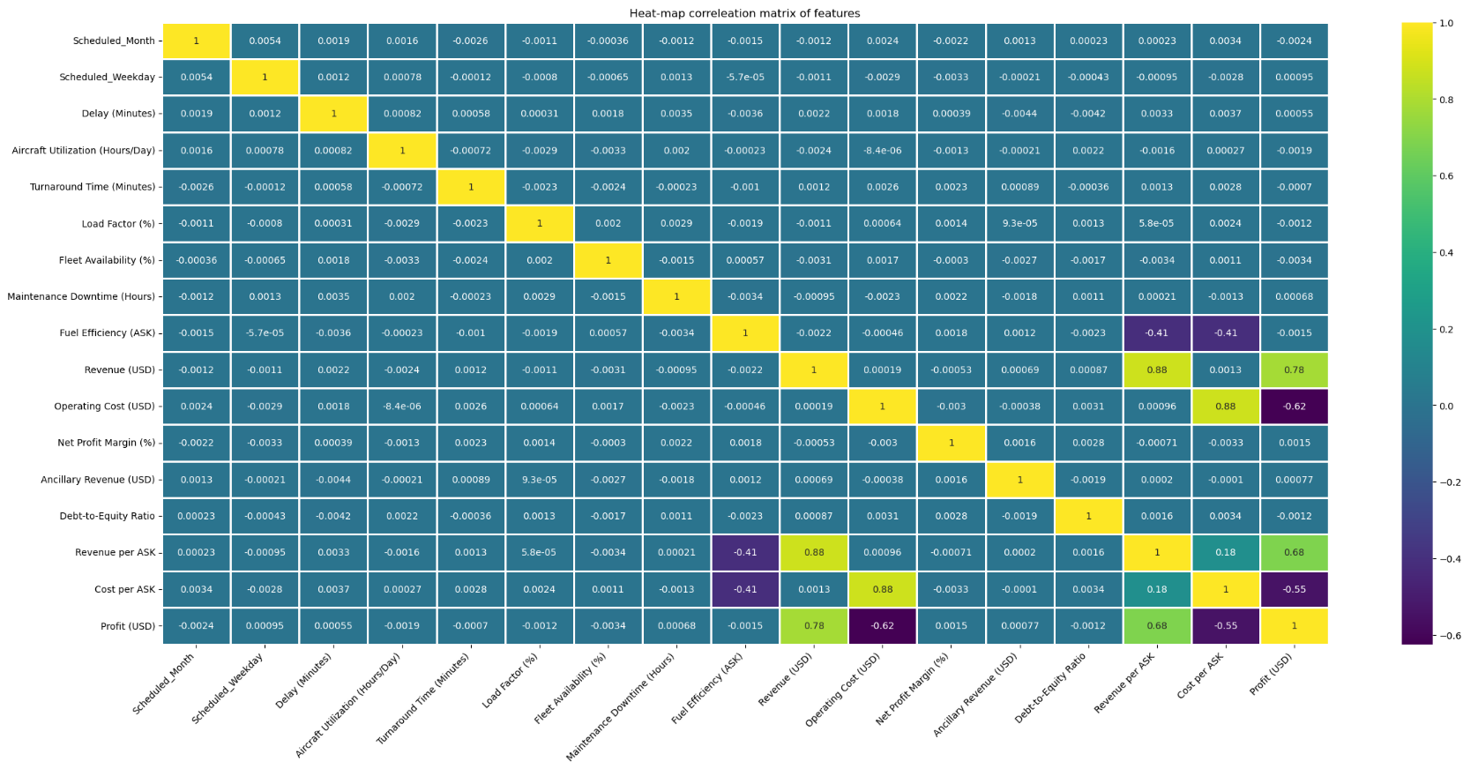
Key visualizations
1. CORRELEATION HEATMAP

Slide 12
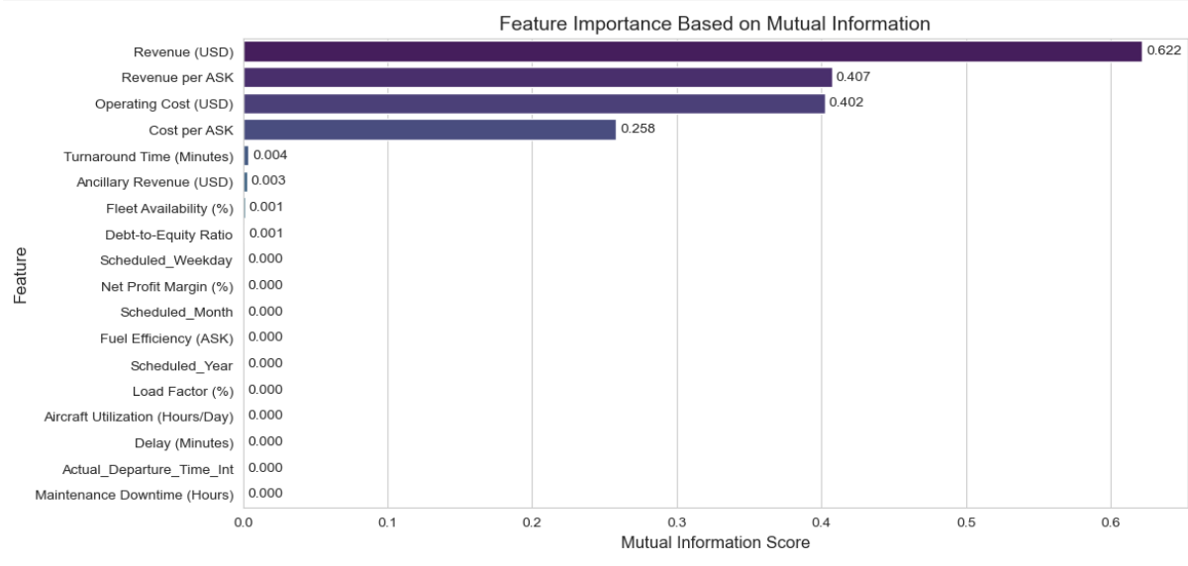
2. FEATURE IMPORTANCE
Take Aways
Revenue (USD), Revenue per ASK, and Operating Cost (USD) are the most important features, while others contribute little to no impact .This suggests that focusing on the top-ranked features could enhance model performance and interpretability.

Slide 13
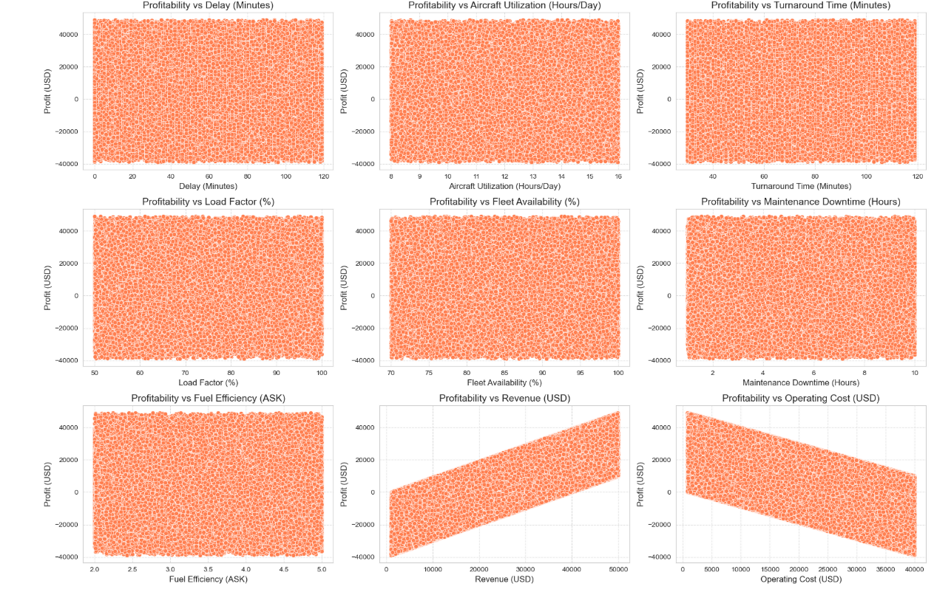
3. PROFITABILITY VS OPERATIONAL METRICS
Take Aways
Revenue positively impacts profitability, while operating costs negatively affect it, with other operational metrics showing minimal direct influence.

Slide 14
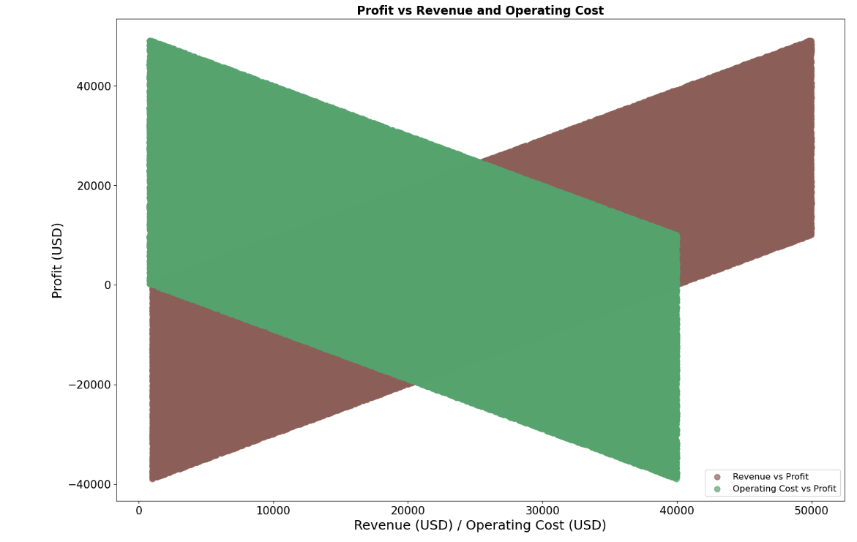
PROFIT VS REVENUE OPERATING COST
Take Aways
Potential Operational Issues: High operating costs could be reducing profits significantly, even when the airline is generating a lot of revenue. This insight may be useful in optimizing costs and improving profitability

Slide 15
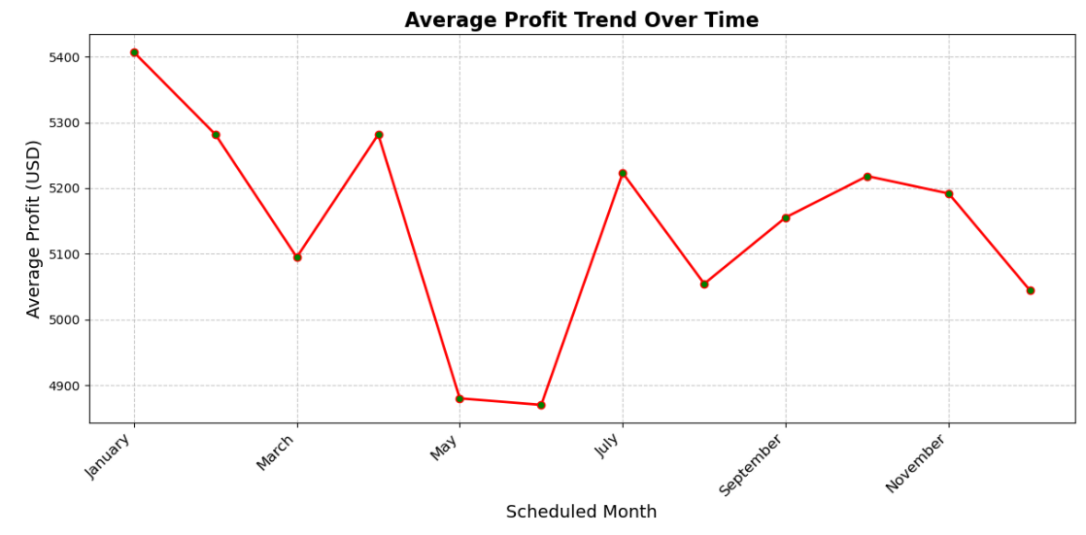
4. SEASONAL TRENDS
Take Aways
The average profit trend shows significant fluctuations throughout the year, with notable peaks in July and dips in May and December, highlighting seasonal and operational influences on profitability.

Slide 16

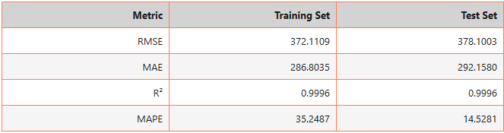
Evaluation Metrics and Model Performance
After parameter tuning and optimization using XGBoost, the model achieved high accuracy with an R-squared value of 0.9996 for both training and test data, indicating excellent fit and predictive power.
RMSE and MAE values are low, confirming strong performance on both datasets.

Slide 17
SUMMARY
XGBoost has performed exceptionally well, with the Actual vs. Predicted plot demonstrating that predictions closely align with the true values.
The Residual Distribution indicates that the errors are evenly distributed, suggesting good model performance.
Additionally, the RMSE and MAE values steadily decrease over epochs, showing that the model is effectively learning and minimizing prediction errors.
These results reflect the power and efficiency of XGBoost in accurately predicting profitability.

Slide 18

Actionable Insights
Optimize Aircraft Utilization:
Higher aircraft utilization can improve profitability. By minimizing downtime and maximizing flight hours, airlines can reduce fixed costs and increase revenue.
Reduce Turnaround Time:
Efficient turnaround times allow for quicker transitions between flights, improving fleet utilization and reducing idle time, which directly impacts profitability.

Slide 19
Focus on Fuel Efficiency: Enhancing fuel efficiency per available seat kilometer (ASK) can significantly lower costs, as fuel is one of the highest expenses for airlines.
Manage Flight Delays:
Minimizing delays helps reduce operational costs and improves customer satisfaction. Timely departures and arrivals also optimize scheduling and resource allocation.
4. Focus on Fuel Efficiency:
Enhancing fuel efficiency per available seat kilometer (ASK) can significantly lower costs, as fuel is one of the highest expenses for airlines.
5. Control Operating Costs:
Close monitoring of maintenance downtime, fleet availability, and operating costs can help identify areas for cost reduction without compromising service quality.

Slide 20
Conclusion and Key Takeaways
Operational Efficiency Matters: Optimizing aircraft utilization, turnaround times, and minimizing delays can significantly improve profitability.
Cost Control is Critical: Managing fuel efficiency and reducing maintenance downtime are crucial for maintaining lower operating costs.
Data-Driven Decisions: The model empowers airlines to make informed, actionable decisions that enhance operational efficiency and profitability.
Seasonal Factors Impact Profitability: Identifying and understanding seasonal trends helps airlines prepare for fluctuations in demand and optimize resources accordingly.

Slide 21

This model serves as a powerful tool to not only predict profitability but also offer strategic insights for optimizing operations and driving long-term growth in the airline industry.

Slide 22
Thank you
TEAM : NEURAL NINJAS

